Slide 1

Major project on MULTI LABEL CLASSIFICATION USING DEEP NEURAL NETWORK
PRESENTED BY:
Aditi Karmakar 201800107
Gaurav Kumar 201800295
Under the guidance of
Mrs. Chitrapriya Ningthoujam
Assistant Professor

Slide 2
TABLE OF CONTENT
SL NO | TITLE | PAGE NO.
1 | Abstract | 3
2 | Introduction | 4 -5
3 | Literature Survey | 6-7
4 | Problem Definition | 8
5 | Solution Strategy | 9
6 | Design | 10
7 | Progress Update, Work to be done | 11
8 | Implementation details | 12
9 | Results | 13-16
10 | Gantt Chart | 17
11 | References | 18

Slide 3
ABSTRACT
Feature extraction - known to be an effective way in reducing computational complexity and increasing accuracy of multi-label image classification.
Image labeling is useful when automating the process of generating meta data or making recommendations to users based on details in their images.
In this project we aim to extract feature from image using CNN and label using KNN algorithms after creation of dataset which will consist of 10 different classes containing images of different genre.

Slide 4
INTRODUCTION
Image Classification
Image classification involves the extraction of features from the image to observe some patterns in the dataset. Using an ANN for the purpose of image classification would end up being very costly in terms of computation since the trainable parameters become extremely large.
Convolutional Neural Network(CNN)
The convolutional neural network (CNN) is a class of deep learning neural networks. CNNs represent a huge breakthrough in image recognition. They’re most commonly used to analyze visual imagery and are frequently working behind the scenes in image classification.

Slide 5
INTRODUCTION
Multi-Label Classification with Deep Learning
Multi-label classification is a predictive modelling task that involves predicting zero or more mutually non-exclusive class labels.
Neural network models can be configured for multi-label classification tasks.

Slide 6
LITERATURE SURVEY
SL NO | AUTHOR,PAPER AND YEAR OF PUBLICATION | FINDINGS | RELEVANCE TO PROJECT
[1] | Jiang Wang1, Yi Yang1 Junhua, Mao2 Zhiheng Huang3∗ Chang Huang4∗ ,Wei Xu1 1Baidu, CNN-RNN: A Unified Framework for Multi–Label image Classification (2016) | The CNN part extracts semantic representations from images; the RNN part models image/label relationship and label dependency | The proposed framework combines the advantages of the joint image/label embedding and label co-occurrence models by employing CNN and RNN to model the label co-occurrence dependency in a joint image/label embedding space.
[2] | Lamia Nabil Mahdy,Kardy Ali Ezzat,Haytham H. Elmousalami, Hassan Aboul Ella,Aboul Ella Hassanien, Automatic X-ray COVID -19 Lung Image Classification System based on Multi-level Thresholding and Support Vector Machine(2020) | Classifies the corona affected X-ray images from others through usage of the deep features. The technique is useful for the clinical practitioners for early detection of COVID-19 infected patients | The model presents high accuracy where the average sensitivity, specificity and accuracy of the lung classification were 95.76%,99.7% and 97.48% respectively.
[3] | Yan Luo(University of Minnesota), Mina Jiang (University of Minnesota),Qi Zhao(University of Minnesota) Visual Attention in Multi-Label Image Classification (2019) | Results show that the new saliency sub-network improves multilabel image classification performance | Analysis of the correlation between visual attention and multi-label image classiﬁcation.

Slide 7
LITERATURE SURVEY
SL NO | AUTHOR,PAPER AND YEAR OF PUBLICATION | FINDINGS | RELEVANCE TO PROJECT
[4] | Francisco Gomez-Donoso, Félix Escalona, Ferran Pérez-Esteve, Miguel Cazorla, Accurate Multilevel Classification for Wildlife images(2021) | Presents an exhaustive study of different methods to perform multilevel classification from colour images applied to the problem of classifying wild animals and plant species. | Experiments show that increasing the resolution of the images impact on the ﬁnal accuracy, as the ﬁner details are very important to determine the exact species of each being are preserved.
[5] | Decubber S., Mortier T., Dembczyński K., WaegemanW. Multi-Label Classification Methods for Image Annotation(2016) | Represents the comparison between different multilabel methods is conducted on image categorization by using scene, flag , corel5k and Nus-wide5k datasets. Experimental results determine that Multi-Label k Nearest is the best performance algorithm. | The graphical performance illustration of accuracy result shows that the classification accuracy of all methods is less than 70% for all datasets including scene, flag, corel5k, NUS-WIDE-5K.

Slide 8
PROBLEM DEFINITION
Multi-Label Classification is more acceptable than Multiclass classification and binary classification for images.
The main challenge in multi-label classification is data imbalance.
Binary classification is dichotomization applied to a practical situation. In many practical binary classification problems, the two groups are not symmetric, and rather than overall accuracy, the relative proportion of different types of errors is of interest.
Convolutional neural networks (CNNs) have shown a great success in single-label image classification but real world images generally contain multiple labels.

Slide 9
SOLUTION STRATEGY
First, load the prepared dataset(consists of 10 different classes) and then pre-process them as per our project’s requirement.
The next step is to define the architecture of the model.
Next is train our model on the training set.
We can use the sigmoid activation function. This will predict the probability for each class independently.
Now we are using CNN models which can do image classification better than humans.
KNN algorithms can be used for multiclass classification.

Slide 10
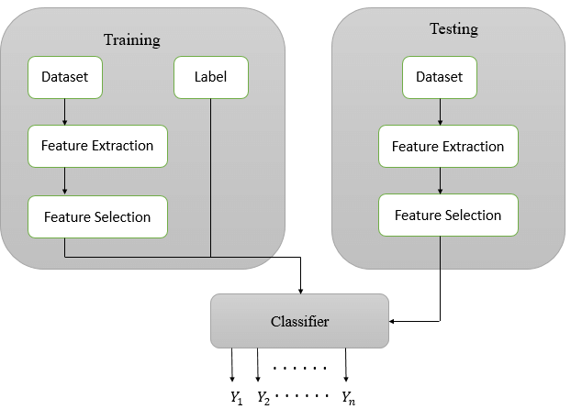
DESIGN
Fig.1 :- Block diagram of Multi-label Classifier

Slide 11
PROGRESS UPDATE
Preparation of the dataset which consists of 2 different folders for training and testing of data respectively. Each folder consists of 10 different classes which include images of: butterflies, chess, cups, food, landscape, plates ,pokemon, pollen grains, spoons, sports respectively.
Training and Testing of the multilabel images using CNN machine learning algorithm .
Preparation of Survey Paper.
The entire code is available in :(https://github.com/MAJOR-PROJECT-GROUP-8)
WORK TO BE DONE
Training and Testing of the multilabel images using KNN machine leaning algorithm.
Comparison between the results obtained via CNN and KNN machine learning algorithms.
Preparation and publication of the research paper.

Slide 12
IMPLEMENTATION DETAILS
We used Keras Framework which is an open source neural network library written in python.
Programming Language -Python
Platform –Jupyter notebook
Data gathering- Images were classified into 10 different classes (butterflies, chess, cups, food, landscape, plates ,pokemon, pollen grains, spoons, sports ) and were extracted from kaggle website. Training dataset consists of 734 images of butterflies, chess, cups, food, landscape, plates ,pokemon, pollen grains, spoons, sports respectively and Testing dataset consists of 346 images of butterflies, chess, cups, food, landscape, plates ,pokemon, pollen grains, spoons, sports respectively .
Libraries imported are: numpy, os, sklearn.metrics, confusion matrix, seaborn, sklearn.utils, shuffle, matplotlib.pyplot , cv2, tensorflow, tqdm.
We define the model as the instance of Sequential() and then just define the layers(Conv2D,MaxPooling2D,Flatten,Dense,Relu).
Loss function used-sparse_categorical_crossentropy . Optimizer used-Adam.
For training our model on our Training data and test the progress of our Validation Data, we define the epochs(number of times we are going to scan our whole training data)to be 15, Batch size=96.

Slide 13
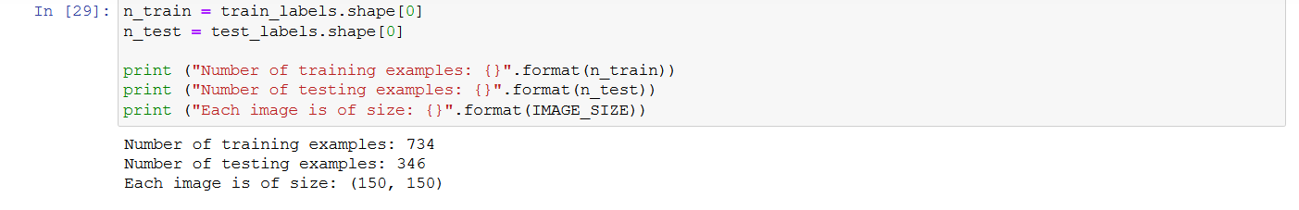
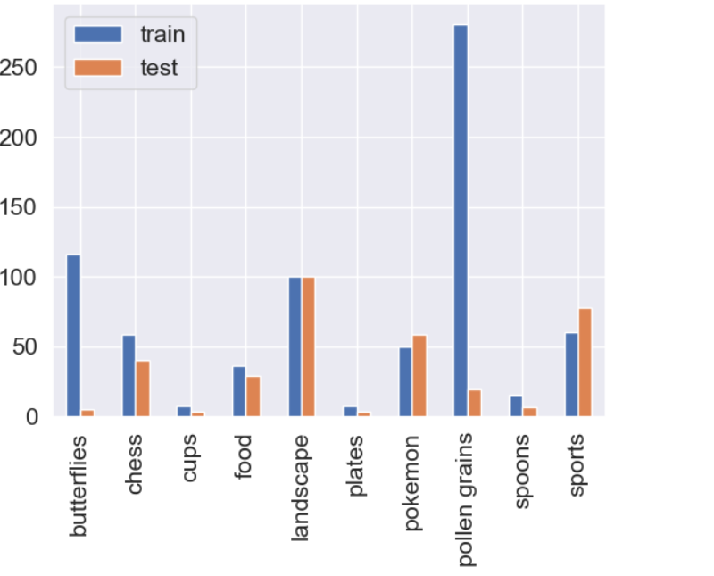
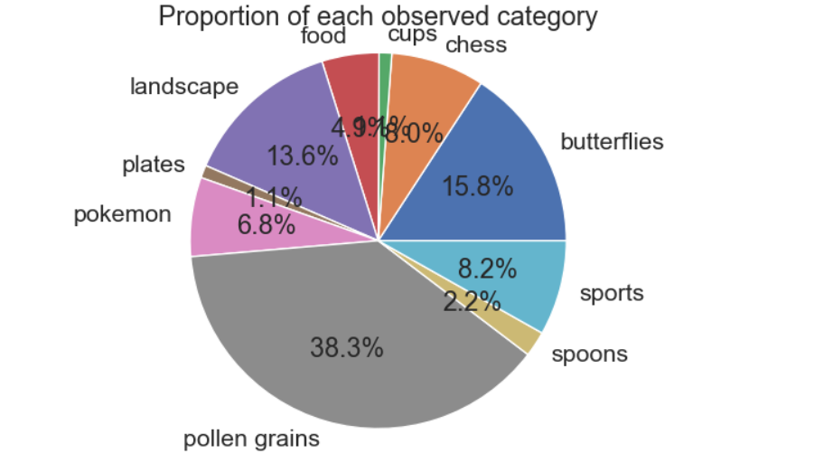
RESULTS
After training and testing using CNN algorithm:
Fig: Graph for training and testing of cnn model, Along x axis: Classes , Along y: axis: No of images
Fig: Pie Chart depicting proportion of each observed category

Slide 14
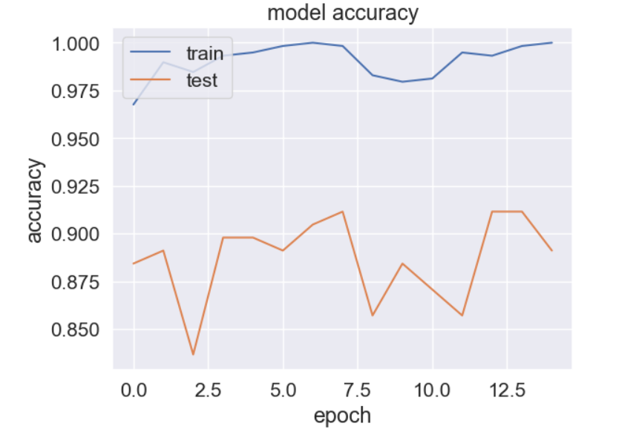
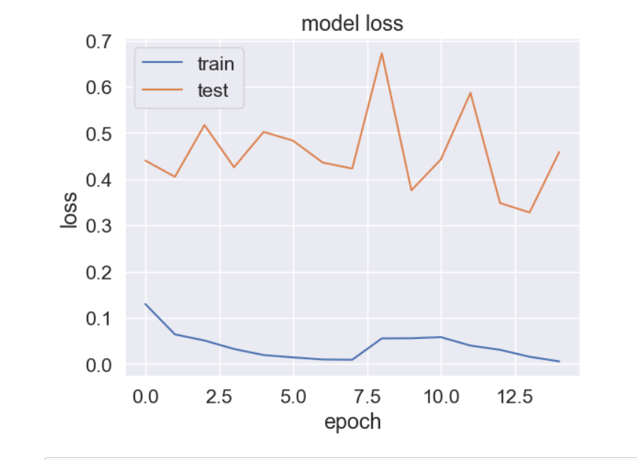
RESULTS
Fig: Model Accuracy graph
Fig: Model Loss graph

Slide 15
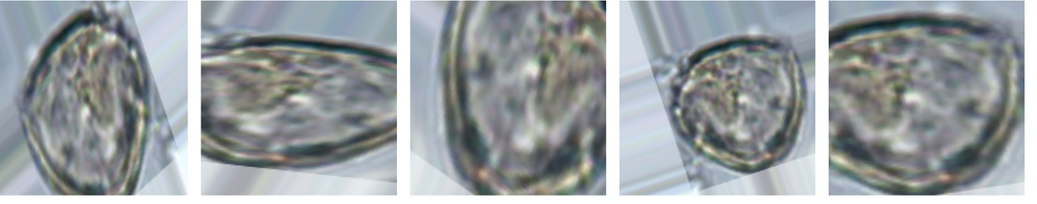
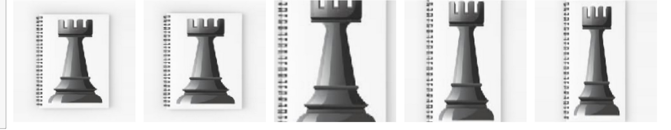
RESULTS
Fig: Augmented images for pollen grains class
Fig: Augmented images for chess class

Slide 16

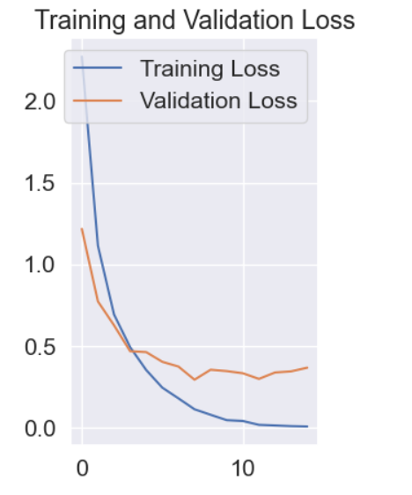
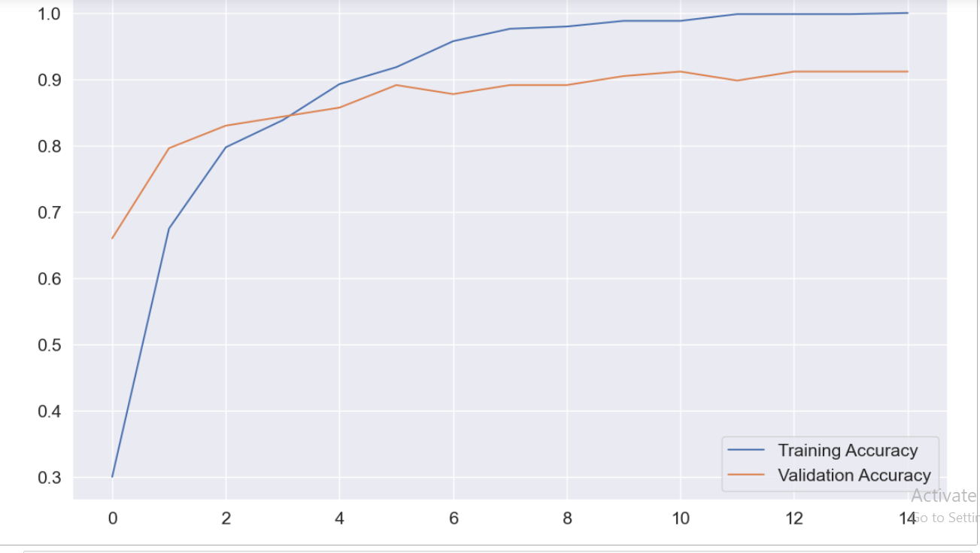
RESULTS
Fig: Training and Validation Accuracy graph
Fig: Training and Validation Loss graph

Slide 17
GANTT CHART
ACTIVITY | February 2022 |  | March 2022 |  | April 2022 |  | May 2022 |  | June 2022
LITERATURE SURVEY
PROBLEM DEFINATION
DESIGN
IMPLEMENTATION
TESTING
REPORT AND DOCUMENTATION
Proposed time frame for task completion
Actual time frame for task completion

Slide 18
REFERENCES
[1] Jiang Wang1 Yi Yang1 Junhua Mao2 Zhiheng Huang3∗ Chang Huang4∗ Wei Xu1 1Baidu Research 2University of California at Los Angles 3Facebook Speech 4 Horizon Robotics,” CNN-RNN:A Uniﬁed Framework for Multi-label Image Classiﬁcation”
[2] Lamia Nabil Mahdy,Kardy Ali Ezzat,Haytham H. Elmousalami, Hassan Aboul Ella,Aboul Ella Hassanien,Higher Technological Institute, Biomedical Engineering Department, Egypt, Faculty of Computers and AI, Cairo University, Cairo ,Egypt, Faculty of Veterinary medicine, Cairo University, Egypt,Scientific Research Group in Egypt(SRGE),”Automatic X-ray COVID-19 Lung Image Classification System Based on Multi-Level Thresholding and Support Vector Machine” http://www.egyptscience.net.
[3] Yan Luo(University of Minnesota), Mina Jiang (University of Minnesota),Qi Zhao(University of Minnesota),”Visual Attention in Mutli-Label Image Classification”, Authorized licensed use limited to: Cornell University Library. Downloaded on August 20,2020 at 09:19:17 UTC from IEEE Xplore.
[4] Francisco Gomez-Donoso, Félix Escalona, Ferran Pérez-Esteve, Miguel Cazorla, "Accurate Multilevel Classification for Wildlife Images", Computational Intelligence and Neuroscience, vol. 2021, Article ID 6690590, 11 pages, 2021. https://doi.org/10.1155/2021/6690590
[5] Decubber S., Mortier T., Dembczyński K., Waegeman W. (2016) Deep F-Measure Maximization in Multi-label Classification: A Comparative Study. In: Berlingerio M., Bonchi F., Gärtner T., Hurley N., Ifrim G. (eds) Multi-Label Classification Methods for Image Annotation(2016). ECML PKDD 2016. Lecture Notes in Computer Science, vol 11051. Springer, Cham. https://doi.org/10.1007/978-3-030-10925-7_18

Slide 19
THANK YOU

